Slide 1
Simple calculator
Prepared by
T.RAMYA
B.HEMASINDHU

Slide 2
ABOUT
Basic Calculator:
In basic calculator to perform the following operations.
1.Addition
2.Subtraction
3.Multiplication
4.Division

Slide 3
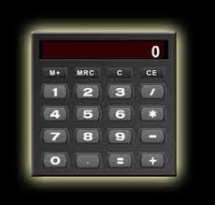
BASIC CALCULATOR

Slide 4
THANK YOU

